Slide 1

IMMIGRATION
By Team Immigration

Slide 2
Team Immigration
Agung Wirayogi (Scrum Master)
Fatin Shahrol
Yangyang Xu
Yue Han Loke
Zaim R Hamdan
Zun Tian Tan

Slide 3
Queensland State Archives
Queensland State Archives connects Queenslanders with their past.
11 open datasets relating to immigrant ships arriving in Queensland with assisted passengers.
Compiled from original records in the collection of Queensland State Archives.
Most highly valued and commonly used datasets for family history research.
Assisted immigration 1848 to 1912, Register of immigrants 1864 to 1878, Register of immigrants Brisbane 1885 to 1917 indexes.

Slide 4
Immigration
Project Goals
To bring the datasets to life through data visualization and infographics
Provide visualized datasets for anyone to discover new discoveries, linkages and trends easily.
Allow users to search for immigrant records.
Allow users to place order for search result through email.

Slide 5
Immigration
Target Users
Anyone from a casual user to academic researchers, e.g.
Family members searching for family history
Academic researchers trying to find a greater understanding of immigration from 1848 - 1917.

Slide 6
Immigration
Immigration - Solution and major design factors
Multi-browser supported website (IE, Chrome, Firefox, Microsoft Edge)
Infographics, e.g.
Top 10 ships’ with the highest voyages,
Top 10 first names of immigrants

Slide 7
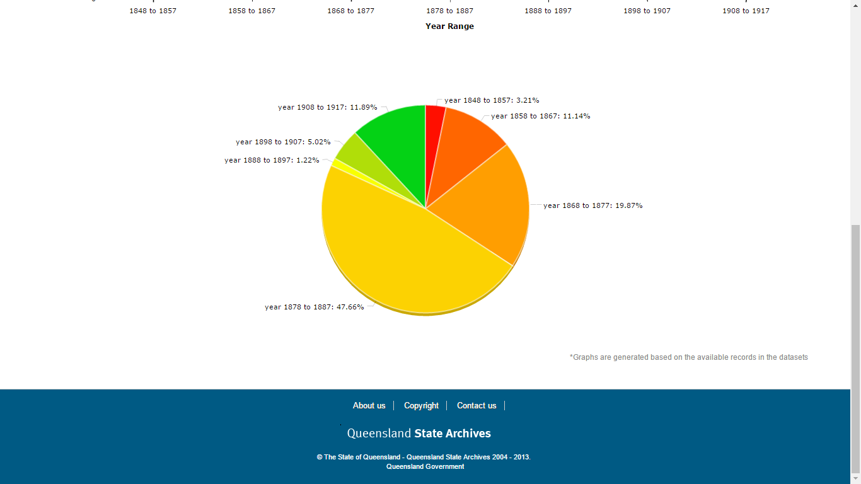
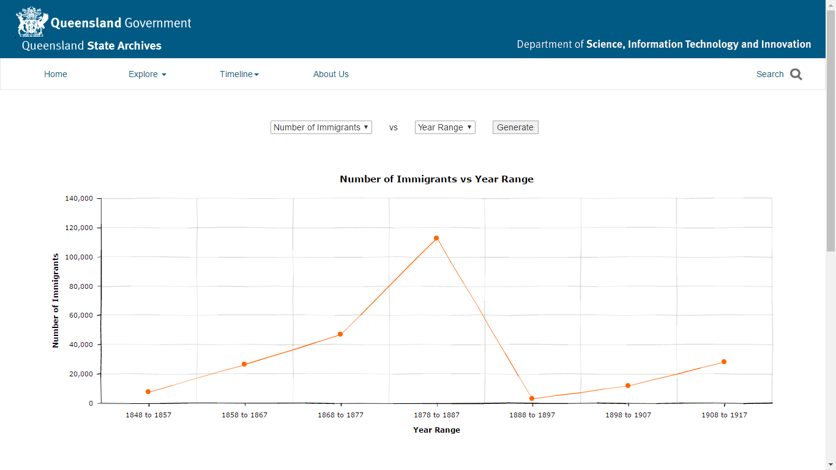
Immigration - Solution and major design factors
Data Visualization
Charts
Line chart and pie chart based on selected x-axis and y-axis.
Ships Voyages
Across 1848-1917
Search feature
Family Name, First Name, Year, Date, Age and Applicant

Slide 8
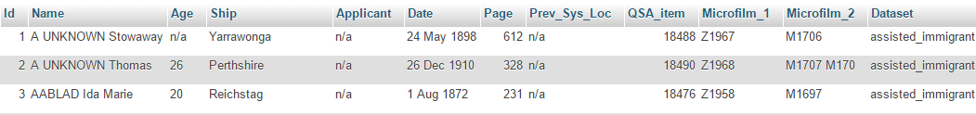
Immigration - Solution and major design factors
Data Cleansing
Analysis
Data Standardization
Automated with Python and Java code
Merging Datasets

Slide 9
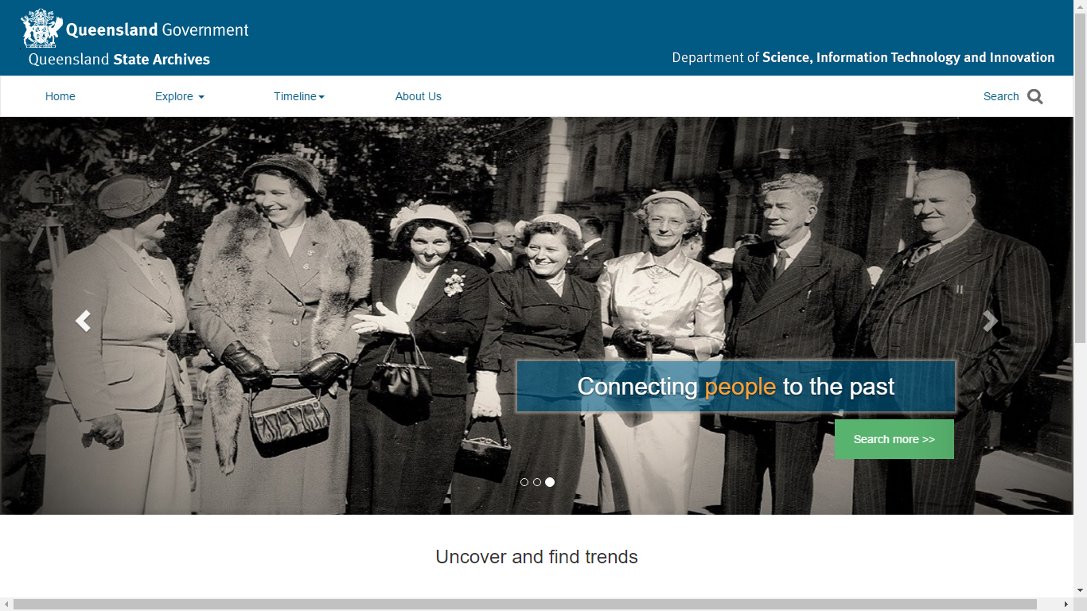
Design Walkthrough - Home Page

Slide 10
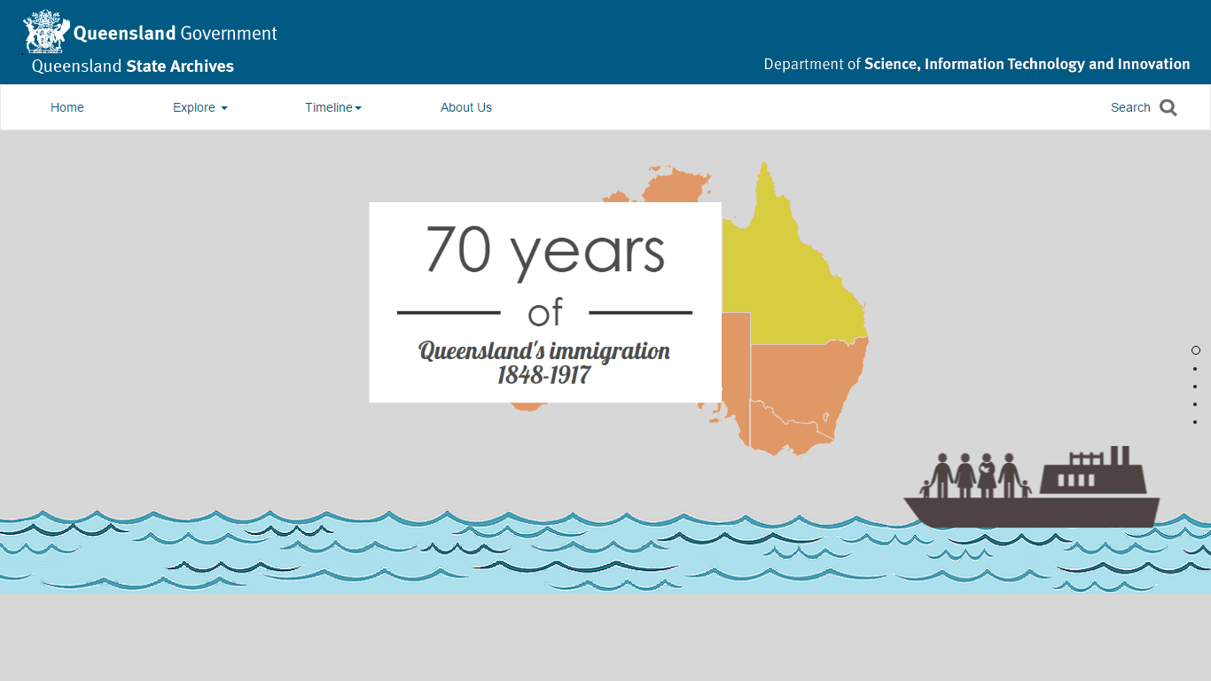
Design Walkthrough - Infographic

Slide 11
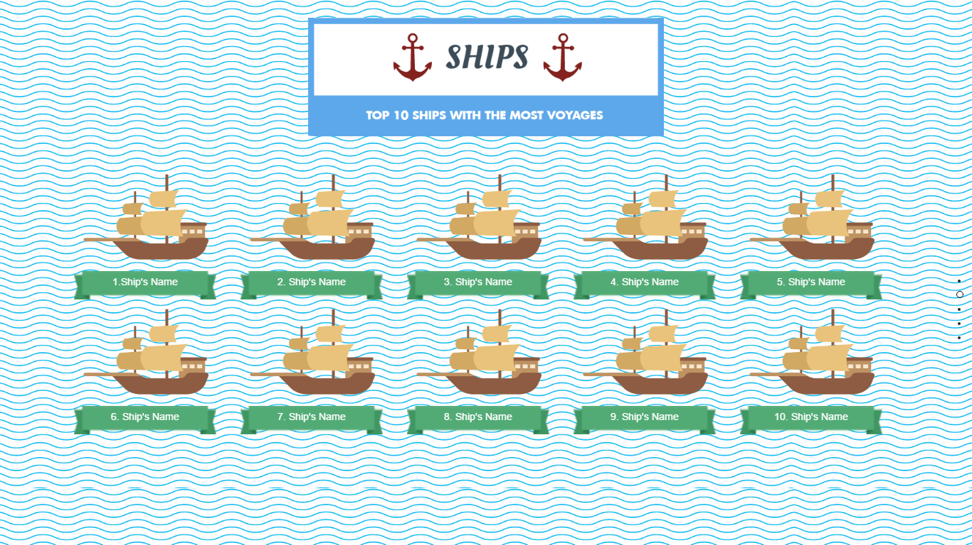
Design Walkthrough - Infographic

Slide 12
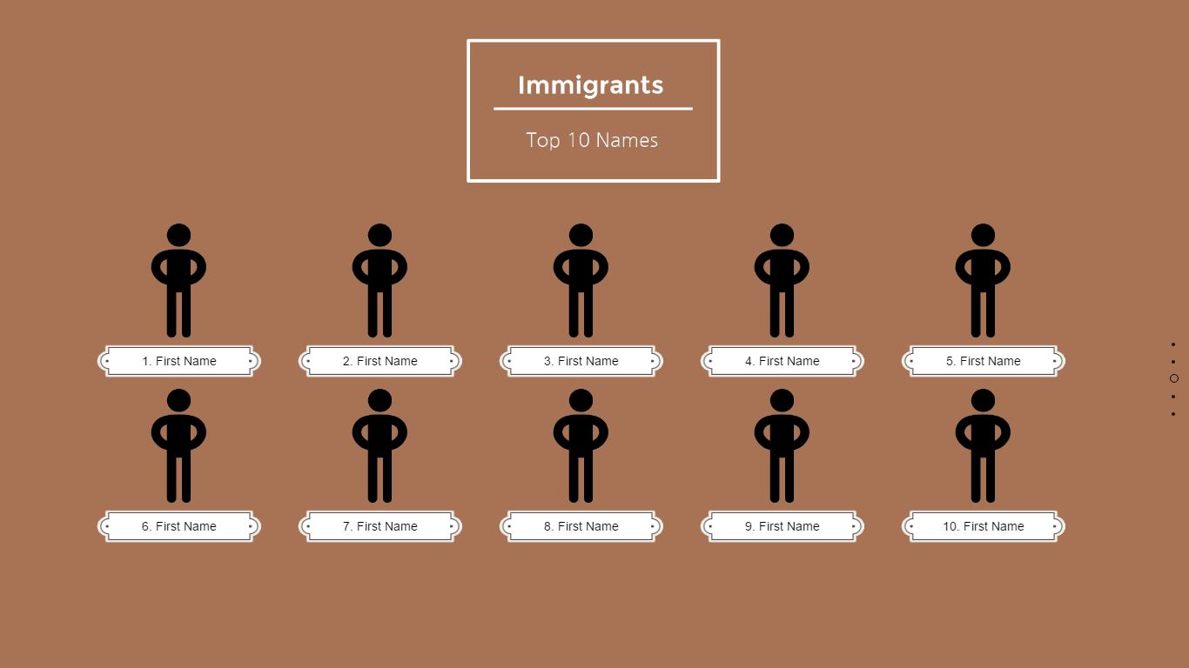
Design Walkthrough - Infographic

Slide 13
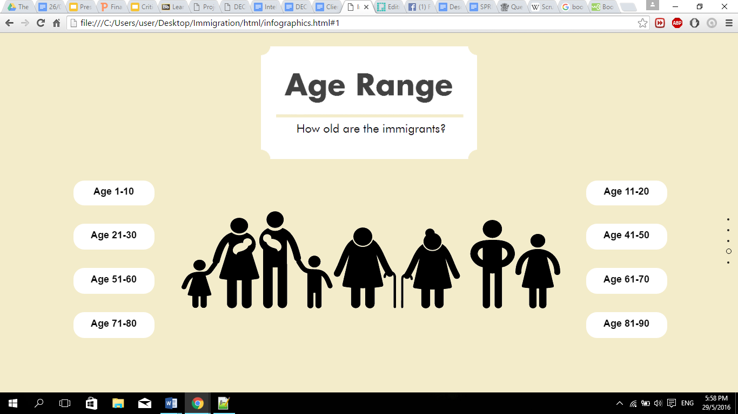
Design Walkthrough - Infographic

Slide 14
Design Walkthrough - Charts

Slide 15
Design Walkthrough - Charts

Slide 16
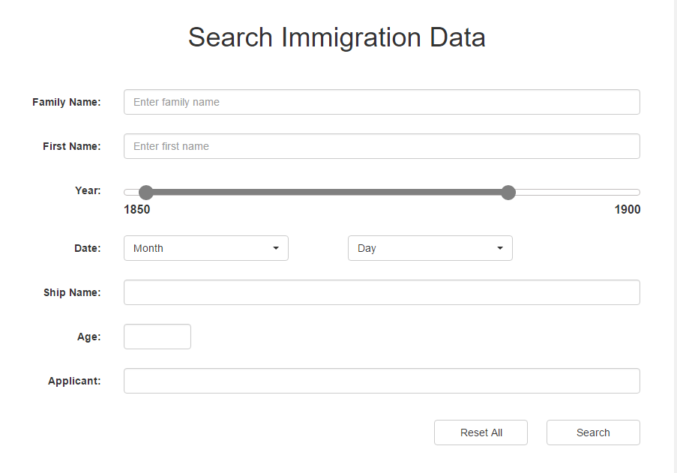
Design Walkthrough - Search

Slide 17
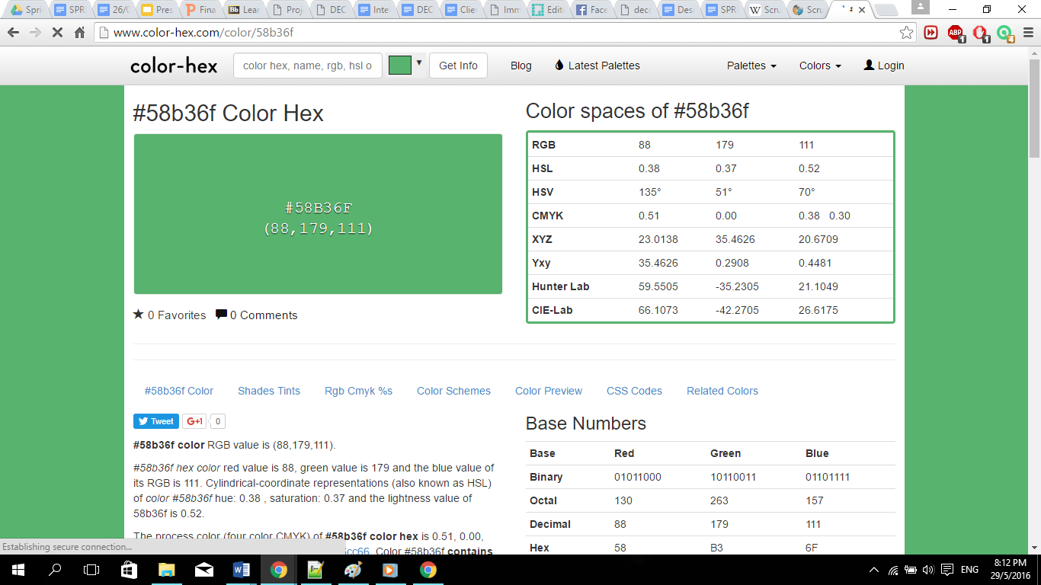
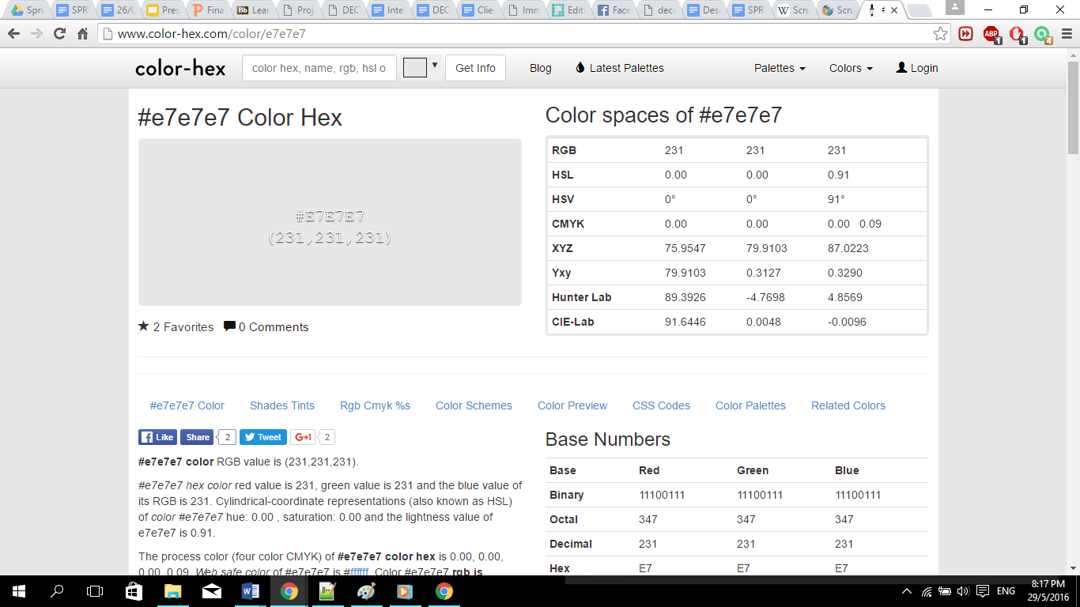

Design Walkthrough - Colours
#005A84
#58B36F
#FFFFFF
#E7E7E7
#FFA339

Slide 18
Project Development Methodology
Weekly Scrum
Stand up for 15 minutes
What did I do in past week?
What will I do in the past week?
What are the challenges I faced?
Sprint Meeting - Every 2 weeks
Sprint Review
Review and plan
Present the part of the work that is completed to client

Slide 19
 | Recommended Skills
Scrum Master | php JavaScript Python Jquery JSON XML AJAX CSS HTML MySQL photoshop | Help the product owner maintain the product backlog Help the team to determine the definition of done for the product Coach the team, within the scrum principles, in order to deliver high-quality features for its product Promote self-organization within the team Facilitate team events to ensure regular progress
Team |  | Self-organized Good discipline Ability to take responsibility Committed Take accountability and ownership

Slide 20
Thank You
Q&A

